Slide 1
Ceramic AM project updates:
04/25/2018
Reported by: Wenbin Li
1. Developing a program for generating 3D printing tool path directedly from PCB file.
2. Next: re-attempt PCB printing.

Slide 2
Gerber files
.PHO
Gerber files
.PHO
Convert one by one using
ACE 3000 translator.
STL files
.stl
Tool path generating program
Stacking STL files in slicing software
Configure the processes flow.
General 3DP file
.gcode
A style converting program.
Executable file for CODE
.ngc
Executable file for CODE
.ngc

Slide 3
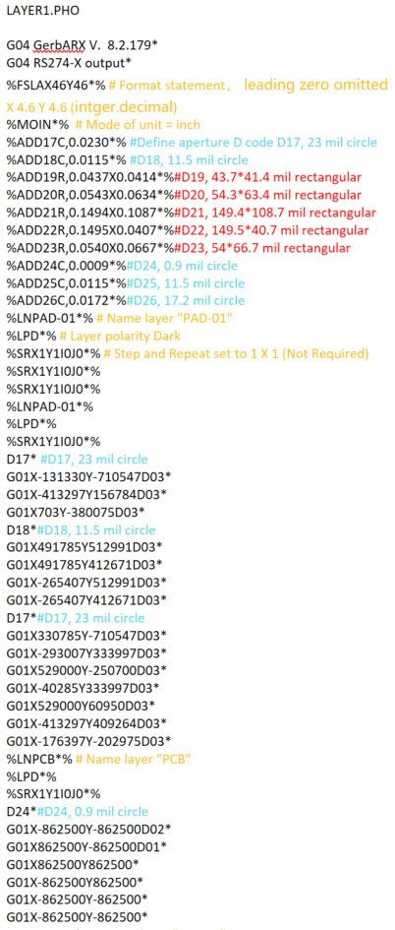
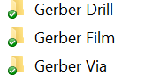
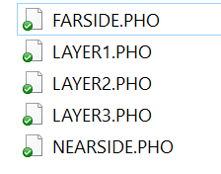
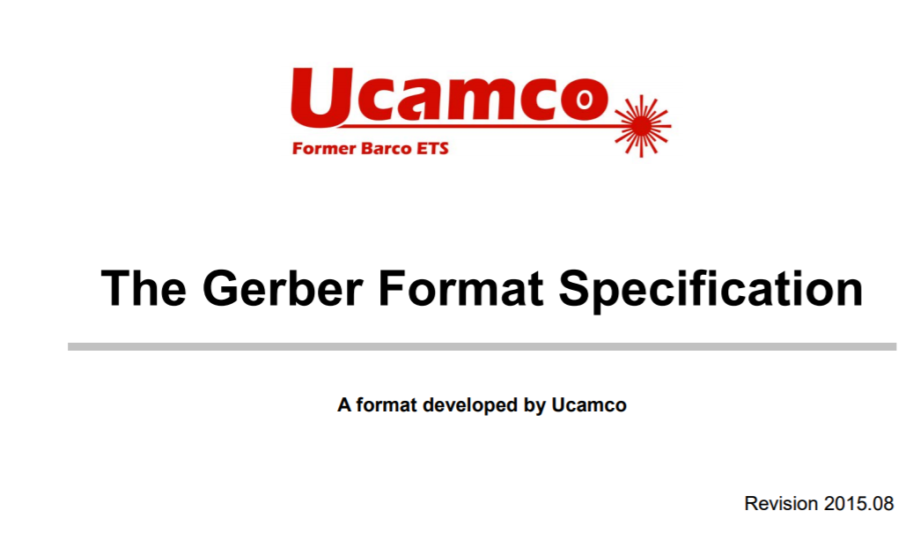
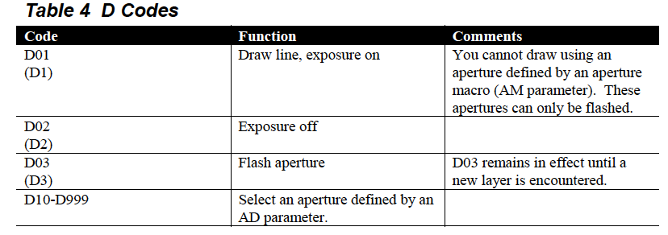
Brief example for interpreting
the Gerber format
Define apertures
Set aperture D17 active
Flashing D17 to create dots
at specific locations
Set aperture D17 active
Move aperture D24 to draw traces

Slide 4
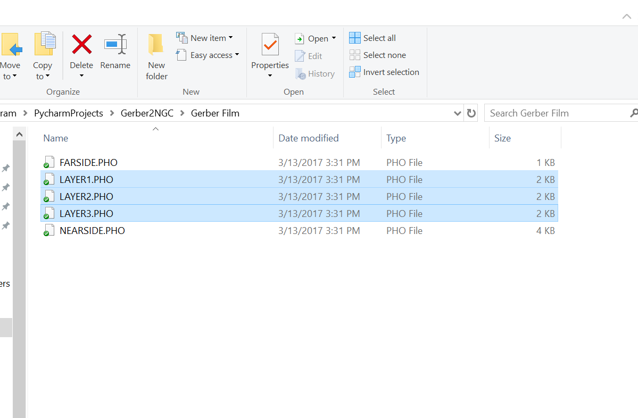
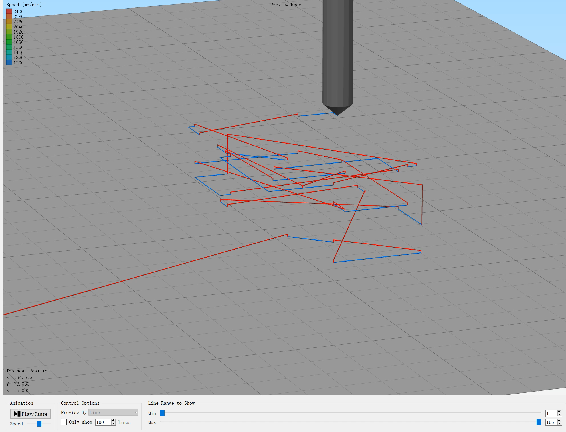
Gcode generated from Gerber files, and previewed
in Simplify3D (3D printing host software)
Red line: nozzle travel movement
Blue line:
Path of conductive traces

Slide 5
Sub-functions of the proposed program:
Generating 3D printing codes for drawing conductive traces.
Generating 3D printing codes for drawing conductive pads.
Generating 3D printing codes for filling vias.
Generating 3D printing codes for dielectric substrates, and via holes.
5. Organizing the above codes to form a excitable G-code file for the CODE machine.
Function 1 and 3 have been developed by now.

